Slide 1
mixup: BEYOND EMPIRICAL RISK MINIMIZATION
이동현

Slide 2


Contribution
a new state-of-the-art performance
increases the robustness of neural networks

Slide 3
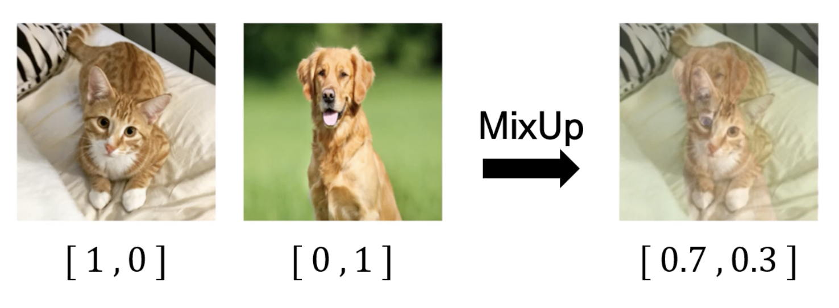

Slide 4
Abstract
Mixup
regularizes the neural network to favor simple linear behavior
reduces the memorization of corrupt labels
increases the robustness to adversarial examples
stabilizes the training of generative adversarial networks

Slide 5
Introduction
neural networks share two commonalities
minimize their average error over the training data (ERM)
size of networks scales linearly with the number of training examples
그런데
ERM의 수렴은 learning machine의 크기가 커지지 않을 때만 보장된다
큰 모델은 일반화하지 않고 분포를 모두 외워버릴 수 있다
-> weak on examples outside the training distribution (overfitting)

Slide 6
Introduction
Vicinal Risk Minimization
data augmentation
additional virtual examples can be drawn from the vicinity distribution of the training examples

Slide 7
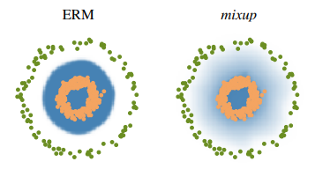
From Empirical Risk Minimization to Mixup
Decision Boundary

Slide 8
What is mixup doing?
implementation of mixup training
straightforward
minimal computation overhead
model trained with mixup - more stable in terms of
model predictions
gradient norms in-between training samples

Slide 9
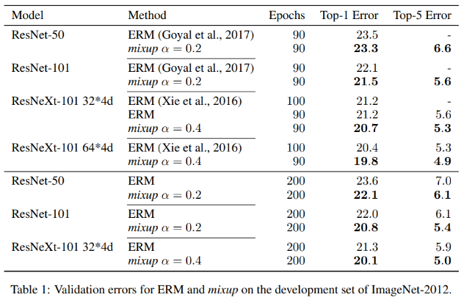

Slide 10
Experiments
IMAGENET CLASSIFICATION
CIFAR-10 AND CIFAR-100
SPEECH DATA
MEMORIZATION OF CORRUPTED LABELS
ROBUSTNESS TO ADVERSARIAL EXAMPLES
TABULAR DATA
STABILIZATION OF GENERATIVE ADVERSARIAL NETWORKS (GANS)

Slide 11
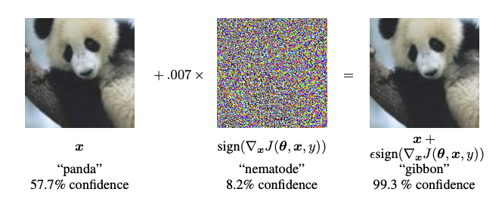

Slide 12
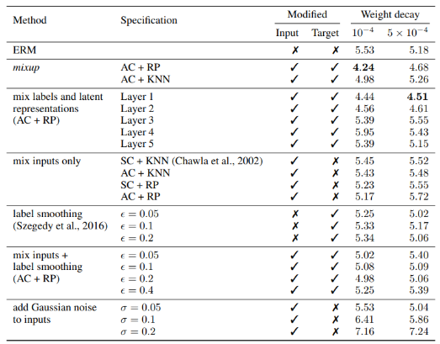
Ablation Studies

Slide 13
Ablation Studies
mixup is the best data augmentation method
the effect of regularization
SMOTE algorithm does not lead to a noticeable gain in performance

Slide 14
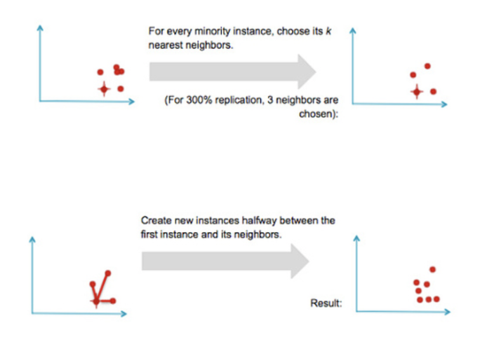

Slide 15
Discussion
with increasingly large α
the training error on real data increases
the generalization gap decreases.
do not yet have a good theory for understanding the ‘sweet spot’ of this bias-variance trade-off
increasing the model capacity would make training error less sensitive to large α -> giving mixup a more significant advantage

Slide 16
Discussion
several possibilities for further exploration
other types of supervised learning problems
ex) regression, structured prediction
beyond supervised learning
ex) feature-label extrapolation to guarantee a robust model behavior far away from the training data

